Slide 1
SqueezeSegV3: Spatially-Adaptive Convolution for Efficient Point-Cloud Segmentation
ECCV 2020
史成章 2020.11.04

Slide 2
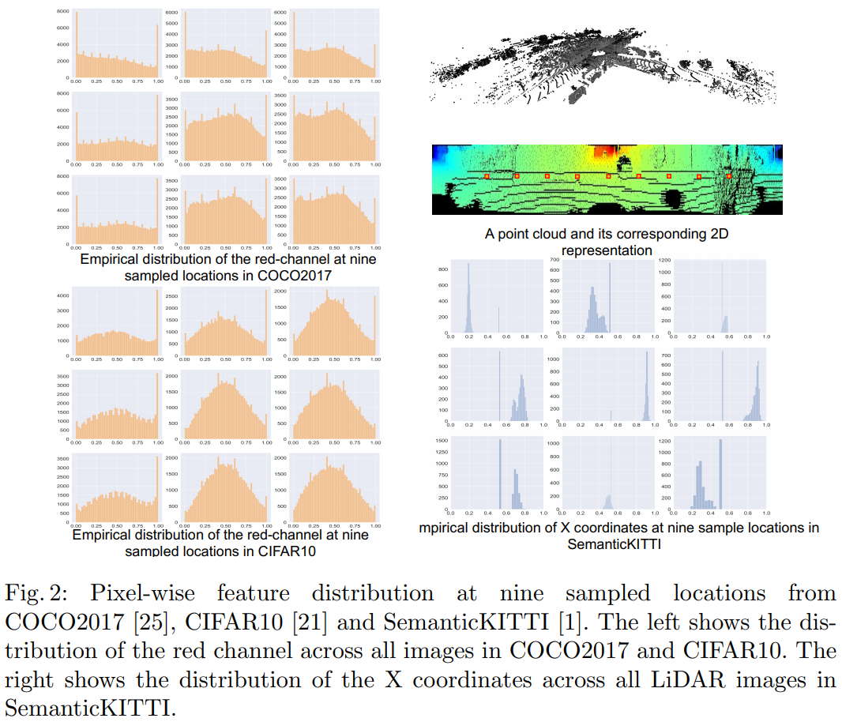

Slide 3
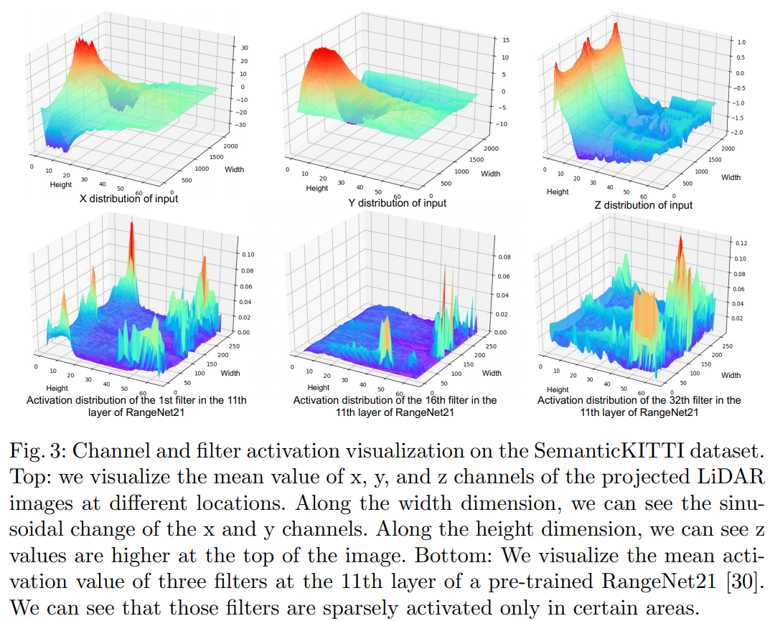

Slide 4
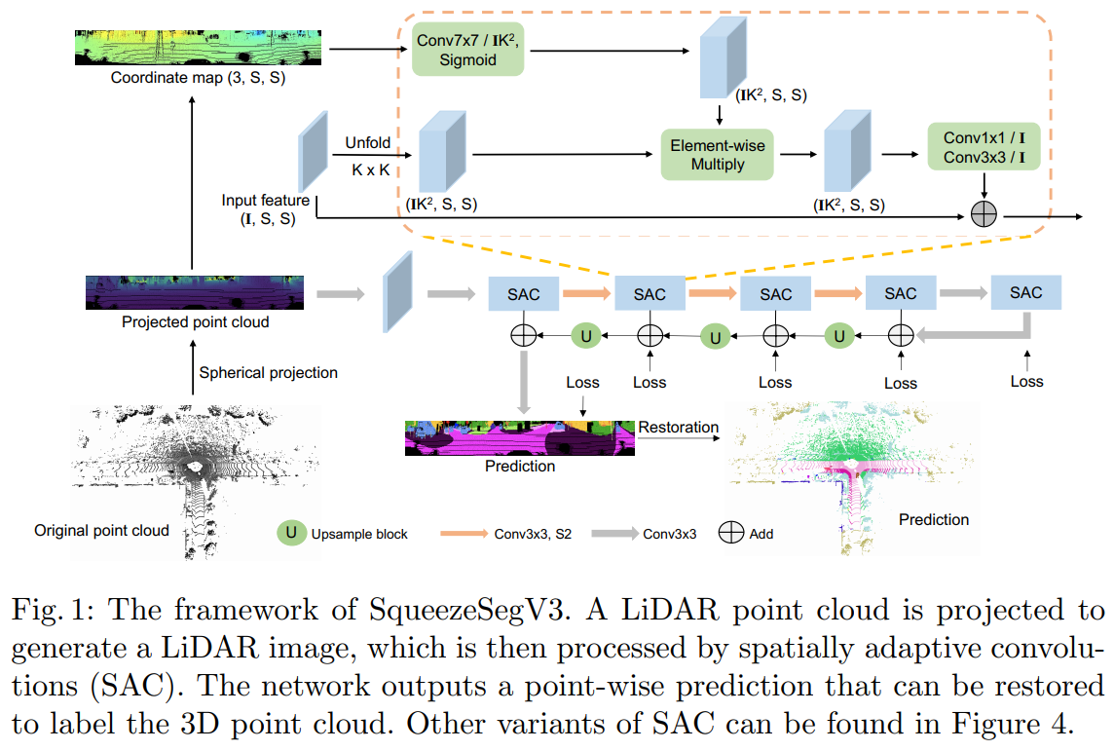

Slide 5




Slide 6
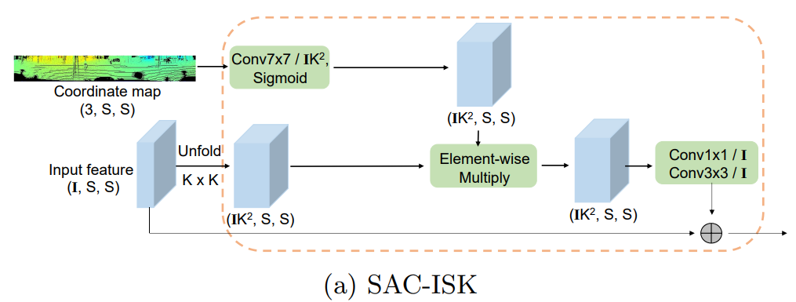
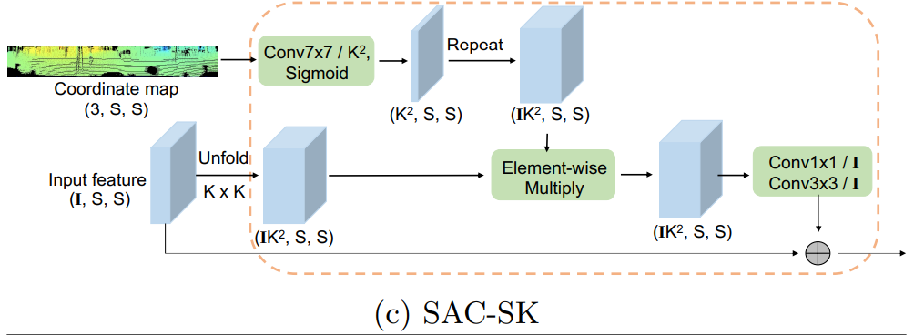
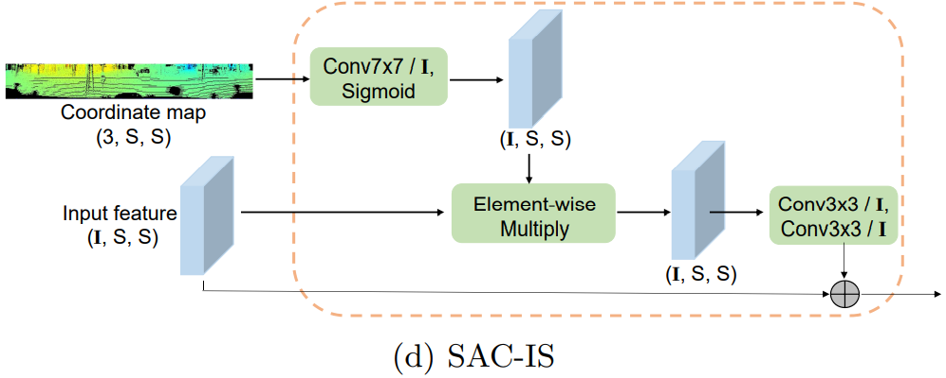



Slide 7


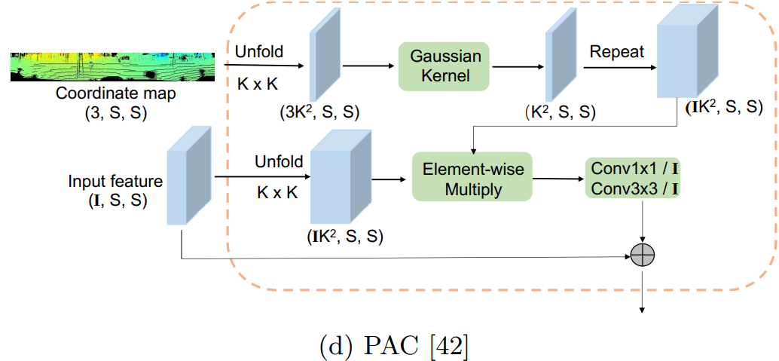
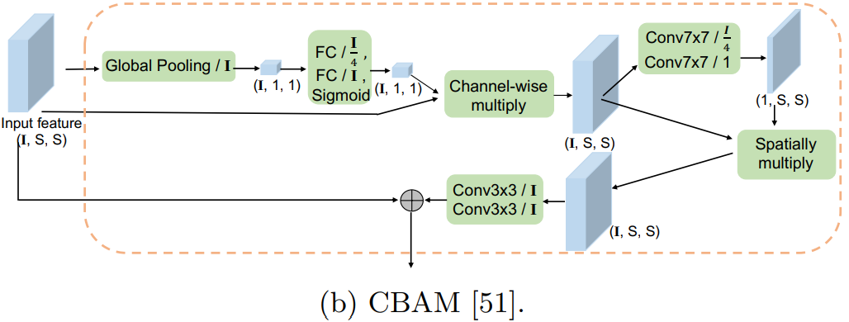
Squeeze-and-excitation networks. CVPR 2018
Squeezesegv2. ICRA 2019
SAC-I
SAC-IS
SAC-I + SAC-S
SAC-SK
Cbam: Convolutional block attention module. ECCV 2018
Pixel adaptive convolutional neural networks. CVPR 2019

Slide 9
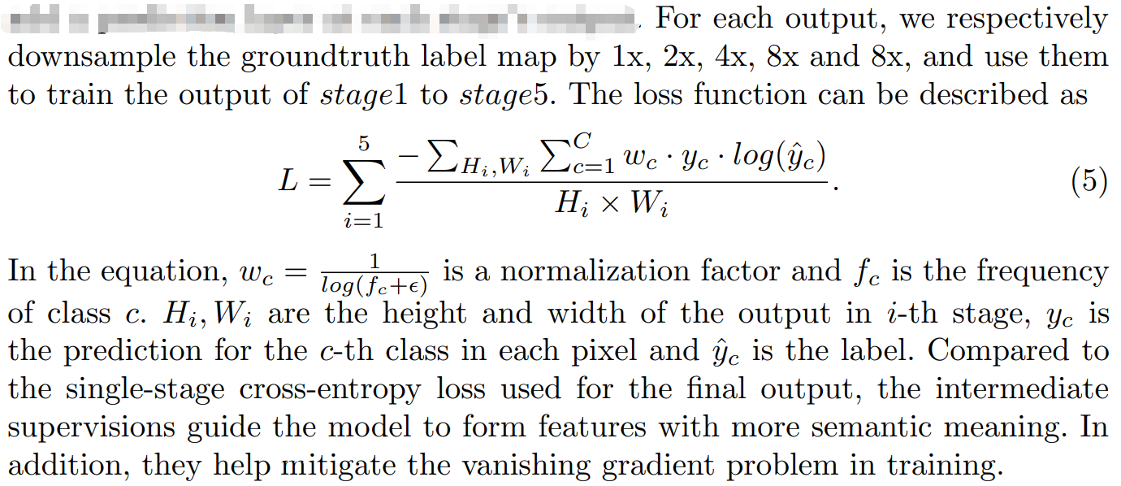

Slide 10
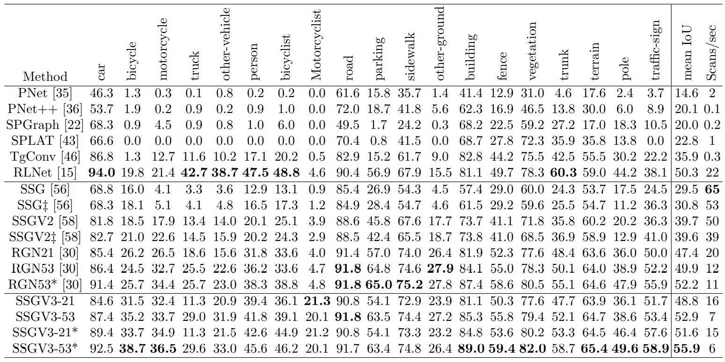

Slide 11

